Slide 1


SMART INDIA HACKATHON 2025
Problem Statement ID – 25049
Problem Statement Title- AI-Driven
Public Health Chatbot for Disease Awareness.
Theme- MedTech/ Bio Tech/HealthTech
PS Category- Software
Team Name – Silver Strikers

Slide 2
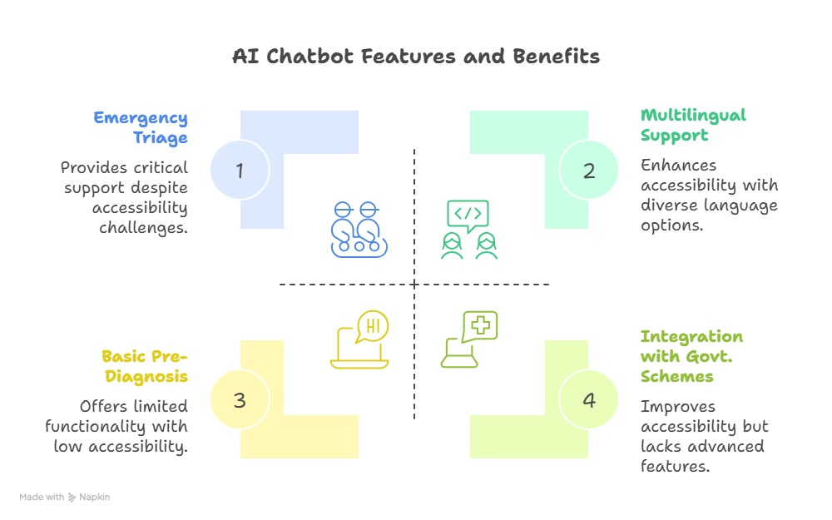
SILVER STRIKERS
AI-Driven Public Health Chatbot for Disease Awareness
Solution
AI chatbot for pre-diagnosis, mental health, wellness, triage
Integrates Govt. health schemes
Multilingual, multimodal, emotionally intelligent
Problem Addressed
Delayed responses, unsafe self-diagnosis
Language barriers in healthcare
Limited access to Govt. health schemes
Uniqueness
Designed for rural and underserved areas
Low cost, lightweight deployment
Emergency and Triage Support (Helpline Number)
Prescription Analysis
Patient Safety disclaimer

Slide 3

TECHNICAL APPROACH
SILVER STRIKERS
Impact:
Citizens: Instant, reliable healthcare guidance.
Govt.: Wider adoption of health schemes.
Doctors: Reduced OPD load, better triaging.
Society: Preventive & holistic healthcare.
Benefits:
Social: Multilingual, empathetic access.
Economic: Cost saving for patients & hospitals.
Health: Self diagnosis, mental well-being.
Emergency: First-aid & hospital redirection.

Slide 4
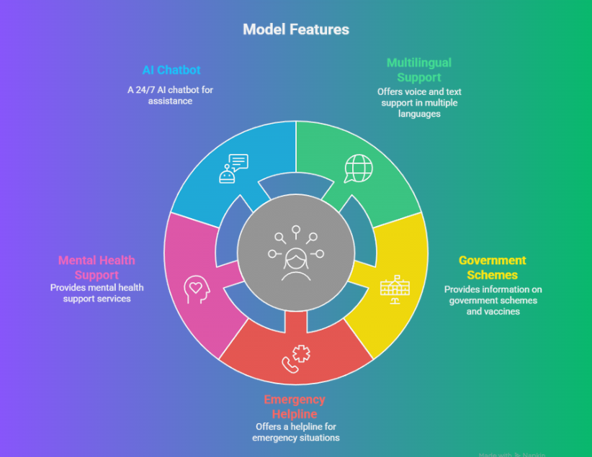
FEASIBILITY AND VIABILITY
SILVER STRIKERS
Feasibility:
Open-source AI & cloud infra
Existing Govt. APIs.
Scalable modular design.
Challenges:
Ensuring medical accuracy
Multilingual complexity
Data privacy & compliance
Solution:

Slide 5
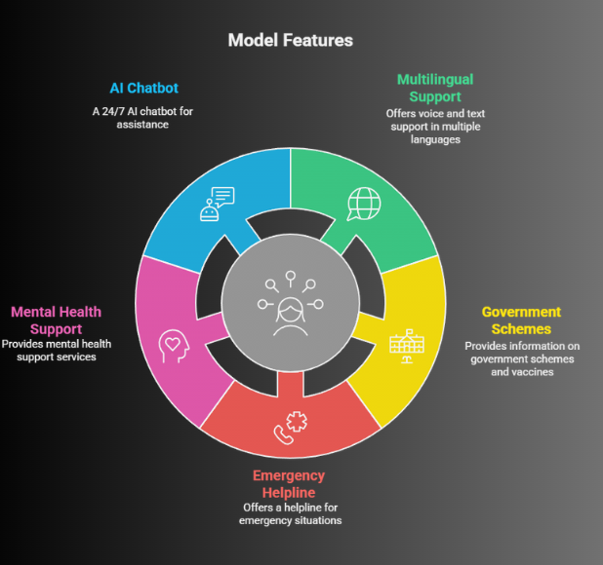
IMPACT AND BENEFITS
SILVER STRIKERS
Impact:
Citizens: Instant, reliable healthcare guidance.
Govt.: Wider adoption of health schemes.
Doctors: Reduced OPD load, better triaging.
Society: Preventive & holistic healthcare.
Benefits:
Social: Multilingual, empathetic access.
Economic: Cost saving for patients & hospitals.
Health: Self diagnosis, mental well-being.
Emergency: First-aid & hospital redirection.

Slide 6

RESEARCH AND REFERENCES
SILVER STRIKERS
Ministry of AYUSH Guidelines
WHO & NHP healthcare resources

Slide 7
Demo of the Prototype with the Problem Statement.
DemoLink -https://drive.google.com/file/d/1MLoG5T3o2V-yVT2GZjZRrVJWJDKXH1rw/view?usp=sharing
Thank You….

